Slide 1
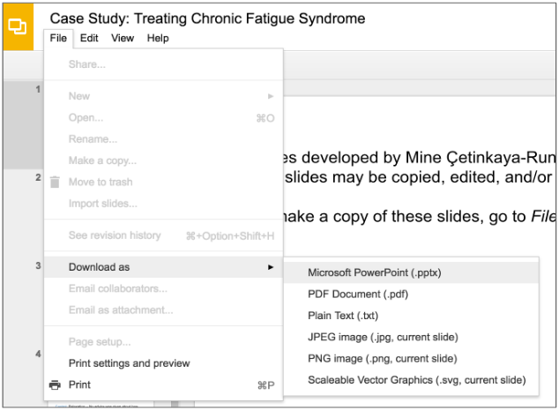
Slides developed by Mine Çetinkaya-Rundel of OpenIntro.
Translated from LaTeX to Google Slides by Curry Hilton of OpenIntro.
The slides may be copied, edited, and/or shared via the CC BY-SA license.
To make a copy of these slides, go to File > Download as > [option], as shown below. Or if you are logged into a Google account, you can choose Make a copy... to create your own version in Google Drive.

Slide 2
Examining
Numerical Data

Slide 3
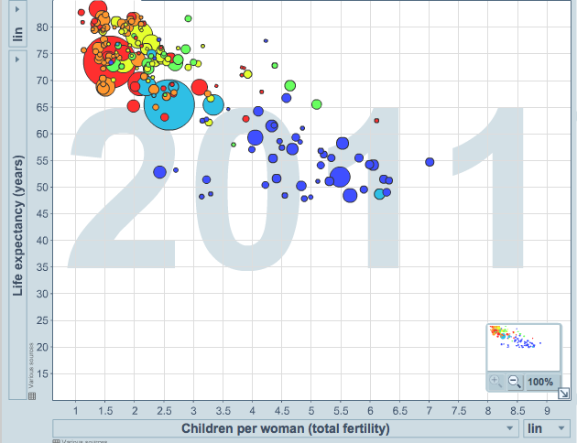
Scatterplot
Scatterplots are useful for visualizing the relationship between two numerical variables.
Do life expectancy and total fertility appear to be associated or independent?
Was the relationship the same throughout the years, or did it change?
http://www.gapminder.org/world

Slide 4
Scatterplot
Scatterplots are useful for visualizing the relationship between two numerical variables.
Do life expectancy and total fertility appear to be associated or independent?
Was the relationship the same throughout the years, or did it change?
They appear to be linearly and negatively associated: as fertility increases, life expectancy decreases.
http://www.gapminder.org/world

Slide 5
Scatterplot
Scatterplots are useful for visualizing the relationship between two numerical variables.
Do life expectancy and total fertility appear to be associated or independent?
Was the relationship the same throughout the years, or did it change?
They appear to be linearly and negatively associated: as fertility increases, life expectancy decreases.
The relationship changed over the years.
http://www.gapminder.org/world

Slide 6
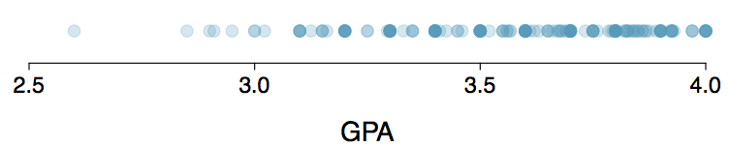
Dot Plots
Useful for visualizing one numerical variable. Darker colors represent areas where there are more observations.
How would you describe the distribution of GPAs in this data set? Make sure to say something about the center, shape, and spread of the distribution.

Slide 7
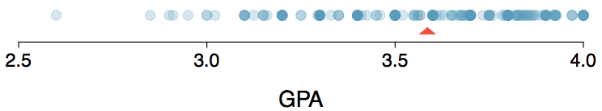
Dot Plots & Mean
The mean, also called the average (marked with a triangle in the above plot), is one way to measure the center of a distribution of data.
The mean GPA is 3.59.

Slide 8

Mean
The sample mean, denoted as x̄, can be calculated as
where x₁, x₂, ..., x_{n} represent the n observed values.
The population mean is also computed the same way but is denoted as µ. It is often not possible to calculate µ since population data are rarely available.
The sample mean is a sample statistic, and serves as a point estimate of the population mean. This estimate may not be perfect, but if the sample is good (representative of the population), it is usually a pretty good estimate.

Slide 9
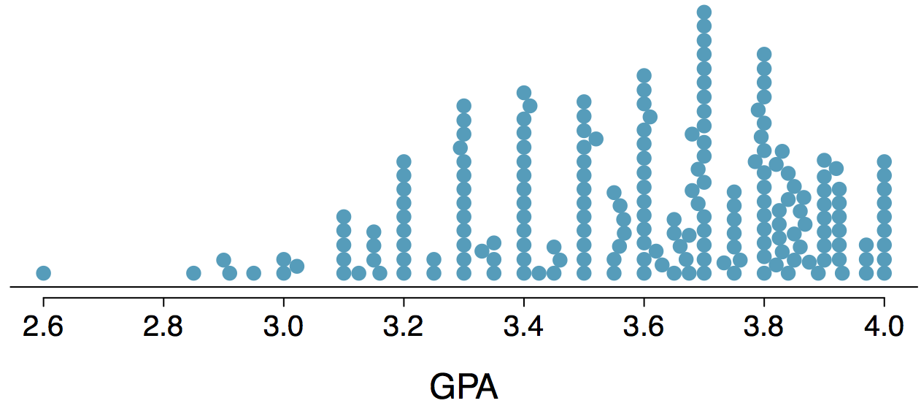
Stacked Dot Plot
Higher bars represent areas where there are more observations, makes it a little easier to judge the center and the shape of the distribution.

Slide 10
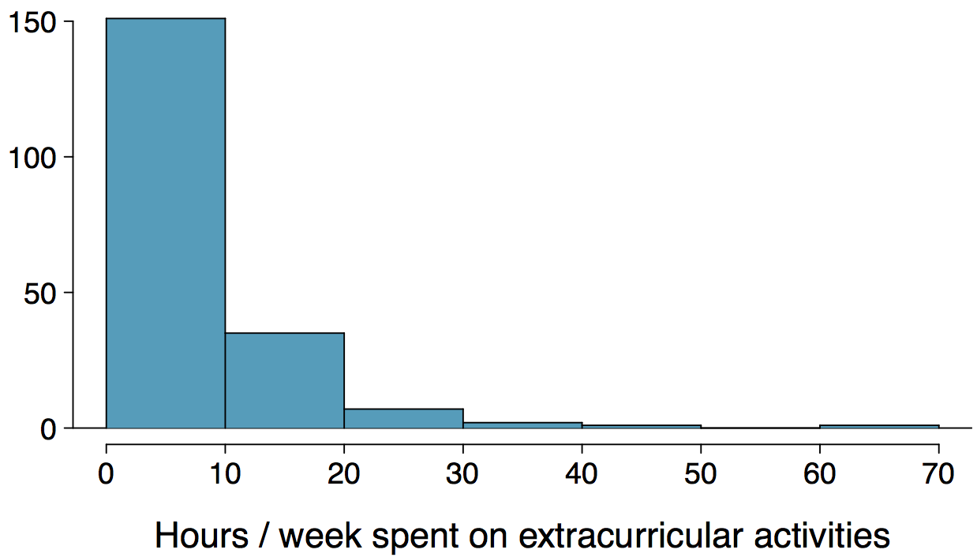
Histograms - Extracurricular Hours
Histograms provide a view of the data density. Higher bars represent where the data are relatively more common.
Histograms are especially convenient for describing the shape of the data distribution.
The chosen bin width can alter the story the histogram is telling.

Slide 11
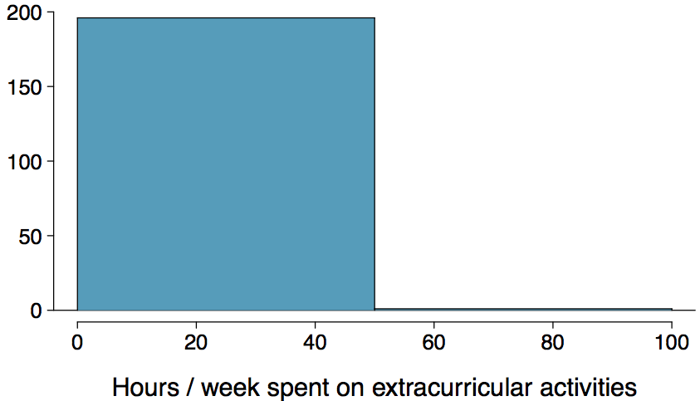
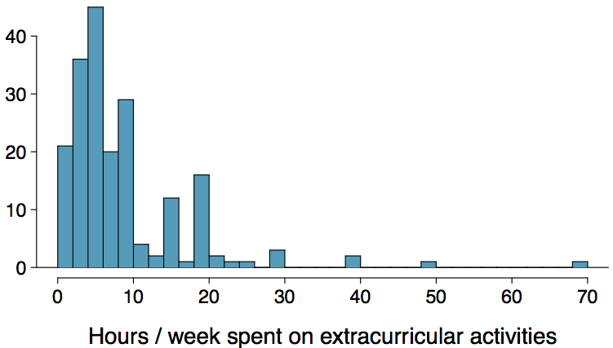
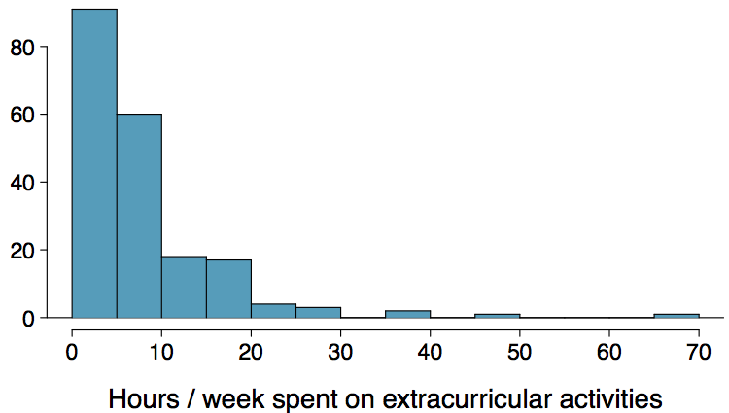
Bin Width
Which one(s) of these histograms are useful? Which reveal too much about the data? Which hide too much?

Slide 12
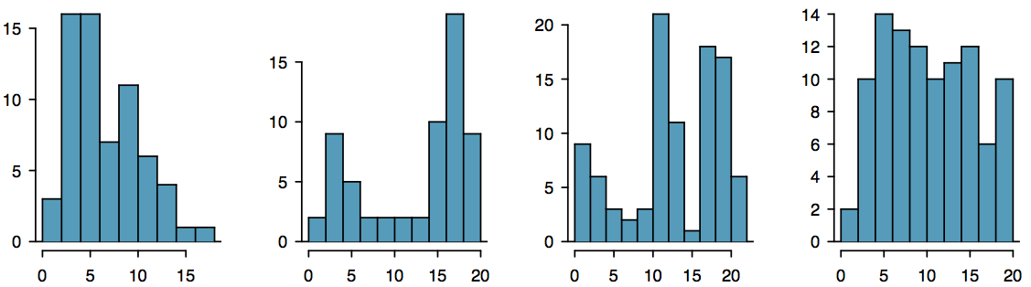
Shape of a Distribution: Modality
Does the histogram have a single prominent peak (unimodal), several prominent peaks (bimodal/multimodal), or no apparent peaks (uniform)?
Note: In order to determine modality, step back and imagine a smooth curve over the histogram -- imagine that the bars are wooden blocks and you drop a limp spaghetti over them, the shape the spaghetti would take could be viewed as a smooth curve.

Slide 13
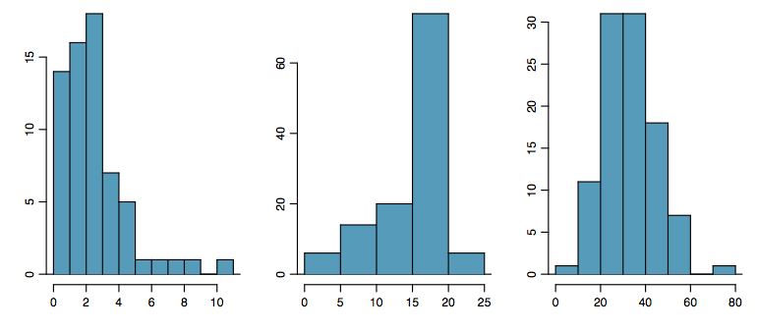
Shape of a Distribution: Skewness
Is the histogram right skewed, left skewed, or symmetric?
Note: Histograms are said to be skewed to the side of the long tail.

Slide 14
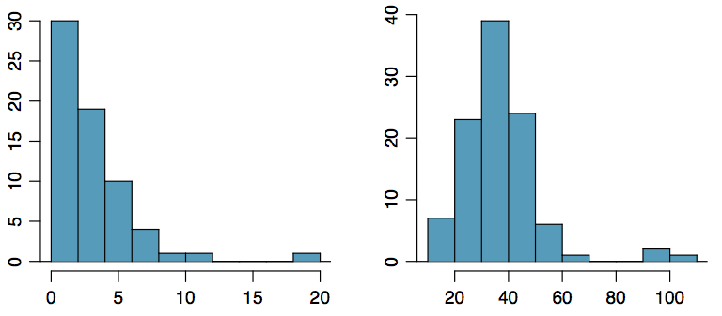
Shape of a Distribution:
Unusual Observations
Are there any unusual observations or potential outliers?

Slide 15
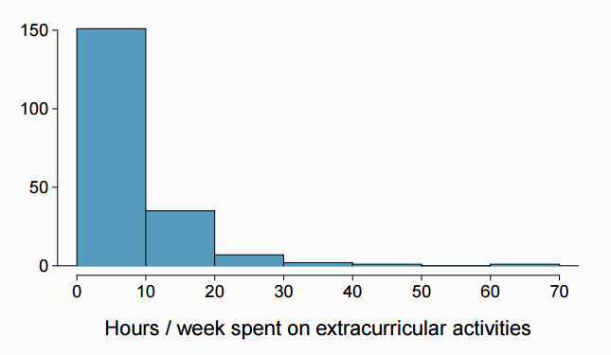
Extracurricular activities
How would you describe the shape of the distribution of hours per week students spend on extracurricular activities?

Slide 16
Extracurricular activities
How would you describe the shape of the distribution of hours per week students spend on extracurricular activities?
Unimodal and right skewed, with a potentially unusual observation at 60 hours/week.

Slide 17
Commonly observed shapes of distributions
Modality

Slide 18
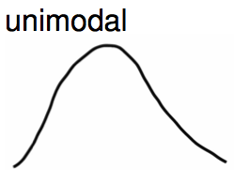
Commonly observed shapes of distributions
Modality

Slide 19
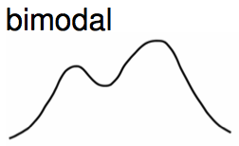
Commonly observed shapes of distributions
Modality

Slide 20
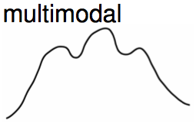
Commonly observed shapes of distributions
Modality

Slide 21
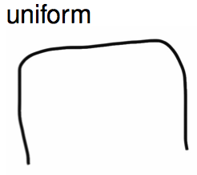
Commonly observed shapes of distributions
Modality

Slide 22
Commonly observed shapes of distributions
Modality
Skewness

Slide 23
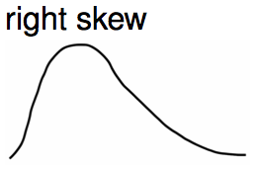
Commonly observed shapes of distributions
Modality
Skewness

Slide 24
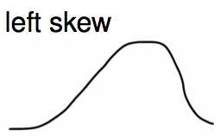
Commonly observed shapes of distributions
Modality
Skewness

Slide 25
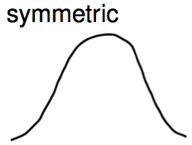
Commonly observed shapes of distributions
Modality
Skewness

Slide 26
Practice
Which of these variables do you expect to be uniformly distributed?
(a) weights of adult females
(b) salaries of a random sample of people from North Carolina
(c) house prices
(d) birthdays of classmates (day of the month)

Slide 27
Practice
Which of these variables do you expect to be uniformly distributed?
(a) weights of adult females
(b) salaries of a random sample of people from North Carolina
(c) house prices
(d) birthdays of classmates (day of the month)

Slide 28
Application Activity:
Shapes of Distributions
Sketch the expected distributions of the following variables:
number of piercings
scores on an exam
IQ scores
Come up with a concise way (1-2 sentences) to teach someone how to determine the expected distribution of any variable.

Slide 29

Are you typical?
http://www.youtube.com/watch?v=4B2xOvKFFz4

Slide 30
Are you typical?
http://www.youtube.com/watch?v=4B2xOvKFFz4
How useful are centers alone for conveying the true characteristics of a distribution?

Slide 31

Variance
Variance is roughly the average squared deviation from the mean.

Slide 32

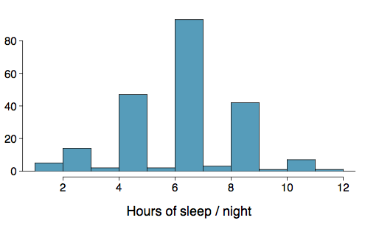
Variance
Variance is roughly the average squared deviation from the mean.
The sample mean is and the sample size is n = 217.

Slide 33
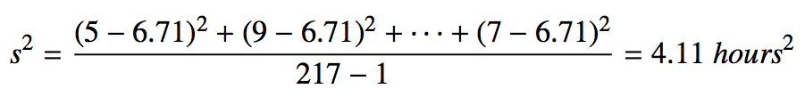
Variance
Variance is roughly the average squared deviation from the mean.
The sample mean is and the sample size is n = 217.
The variance of amount of sleep students get per night can be calculated as:

Slide 34
Variance (cont.)
Why do we use the squared deviation in the calculation of variance?

Slide 35
Variance (cont.)
Why do we use the squared deviation in the calculation of variance?
To get rid of negatives so that observations equally distant from the mean are weighed equally.
To weigh larger deviations more heavily.

Slide 36

Standard Deviation
The standard deviation is the square root of the variance, and has the same units as the data.

Slide 37
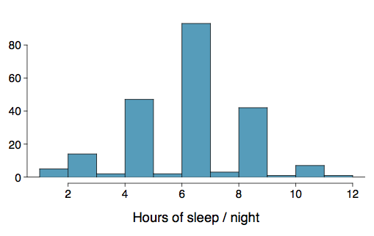

Standard Deviation
The standard deviation is the square root of the variance, and has the same units as the data.
The standard deviation of amount of sleep students get per night can be calculated as:

Slide 38
Standard Deviation
The standard deviation is the square root of the variance, and has the same units as the data.
The standard deviation of amount of sleep students get per night can be calculated as:
We can see that all of the data are within 3 standard deviations of the mean.

Slide 39

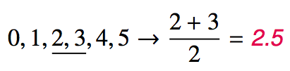
Median
The median is the value that splits the data in half when ordered in ascending order.
If there are an even number of observations, then the median is the average of the two values in the middle.
Since the median is the midpoint of the data, 50% of the values are below it. Hence, it is also the 50th percentile.

Slide 40
Q1, Q3, and IQR
The 25th percentile is also called the first quartile, Q1.
The 50th percentile is also called the median.
The 75th percentile is also called the third quartile, Q3.
Between Q1 and Q3 is the middle 50% of the data. The range these data span is called the interquartile range, or the IQR.
IQR = Q3 - Q1

Slide 41
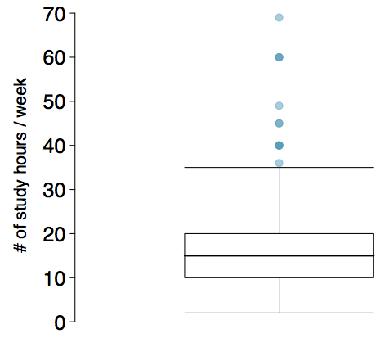
Box Plot
The box in a box plot represents the middle 50% of the data, and the thick line in the box is the median.

Slide 42
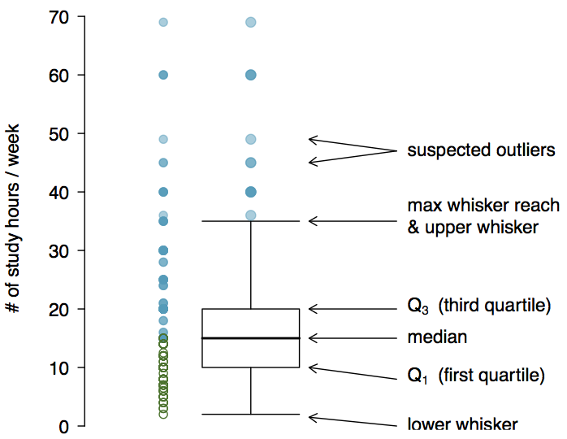
Anatomy of a Box Plot

Slide 43
Whiskers and Outliers
Whiskers of a box plot can extend up to 1.5 x IQR away from the quartiles.
max upper whisker reach = Q3 + 1.5 x IQR
max lower whisker reach = Q1 - 1.5 x IQR

Slide 44
Whiskers and Outliers
Whiskers of a box plot can extend up to 1.5 x IQR away from the quartiles.
max upper whisker reach = Q3 + 1.5 x IQR
max lower whisker reach = Q1 - 1.5 x IQR
IQR: 20 - 10 = 10
max upper whisker reach = 20 + 1.5 x 10 = 35
max lower whisker reach = 10 - 1.5 x 10 = -5

Slide 45
Whiskers and Outliers
Whiskers of a box plot can extend up to 1.5 x IQR away from the quartiles.
max upper whisker reach = Q3 + 1.5 x IQR
max lower whisker reach = Q1 - 1.5 x IQR
IQR: 20 - 10 = 10
max upper whisker reach = 20 + 1.5 x 10 = 35
max lower whisker reach = 10 - 1.5 x 10 = -5
A potential outlier is defined as an observation beyond the maximum reach of the whiskers. It is an observation that appears extreme relative to the rest of the data.

Slide 46
Outliers (cont.)
Why is it important to look for outliers?

Slide 47
Outliers (cont.)
Why is it important to look for outliers?
Identify extreme skew in the distribution.
Identify data collection and entry errors.
Provide insight into interesting features of the data.

Slide 48
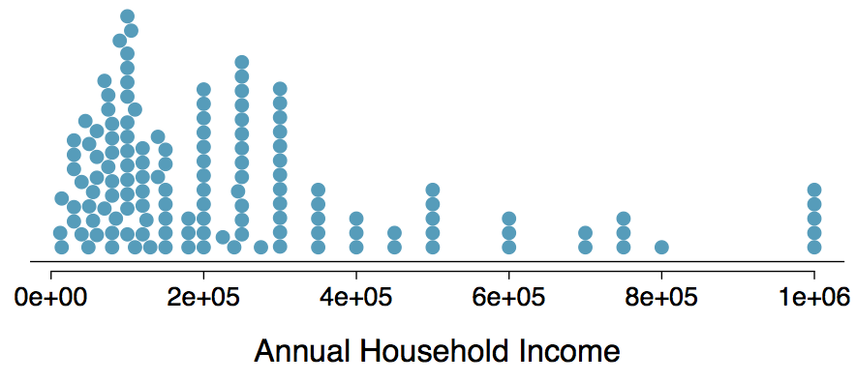
Extreme Observations
How would sample statistics such as mean, median, SD, and IQR of household income be affected if the largest value was replaced with $10 million? What if the smallest value was replaced with $10 million?

Slide 49
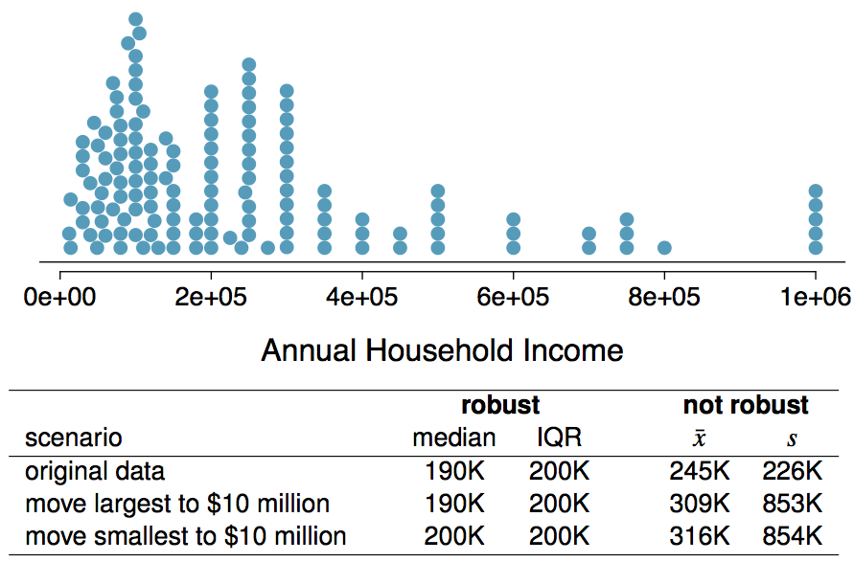
Robust Statistics

Slide 50
Robust Statistics
Median and IQR are more robust to skewness and outliers than mean and SD. Therefore,
for skewed distributions it is often more helpful to use median and IQR to describe the center and spread
for symmetric distributions it is often more helpful to use the mean and SD to describe the center and spread

Slide 51
Robust Statistics
Median and IQR are more robust to skewness and outliers than mean and SD. Therefore,
for skewed distributions it is often more helpful to use median and IQR to describe the center and spread
for symmetric distributions it is often more helpful to use the mean and SD to describe the center and spread
If you would like to estimate the typical household income for a student, would you be more interested in the mean or median income?

Slide 52
Robust Statistics
Median and IQR are more robust to skewness and outliers than mean and SD. Therefore,
for skewed distributions it is often more helpful to use median and IQR to describe the center and spread
for symmetric distributions it is often more helpful to use the mean and SD to describe the center and spread
If you would like to estimate the typical household income for a student, would you be more interested in the mean or median income?
Median

Slide 53
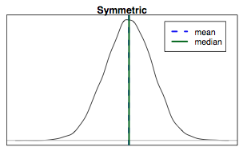
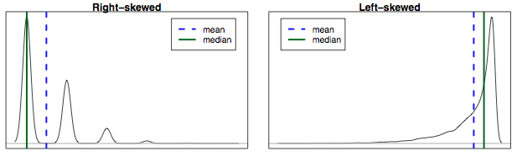
Mean vs. Median
If the distribution is symmetric, center is often defined as the mean: mean ~ median
If the distribution is skewed or has extreme outliers, center is often defined as the median
Right-skewed: mean > median
Left-skewed: mean < median

Slide 54
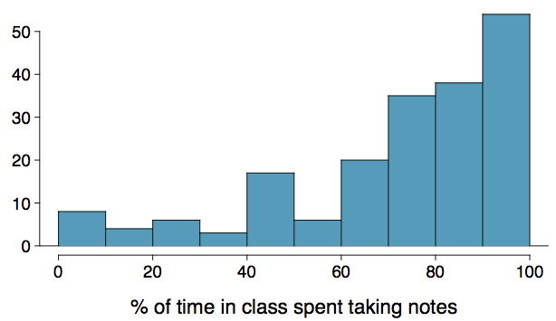
Practice
Which is most likely true for the distribution of percentage of time actually spent taking notes in class versus on Facebook, Twitter, etc.?
(a) mean > median (b) mean ~ median
(c) mean < median (d) impossible to tell

Slide 55
Practice
Which is most likely true for the distribution of percentage of time actually spent taking notes in class versus on Facebook, Twitter, etc.?
median: 80%
mean: 76%
(a) mean > median (b) mean ~ median
(c) mean < median (d) impossible to tell

Slide 56
Extremely Skewed Data
When data are extremely skewed, transforming them might make modeling easier. A common transformation is the log transformation.

Slide 57
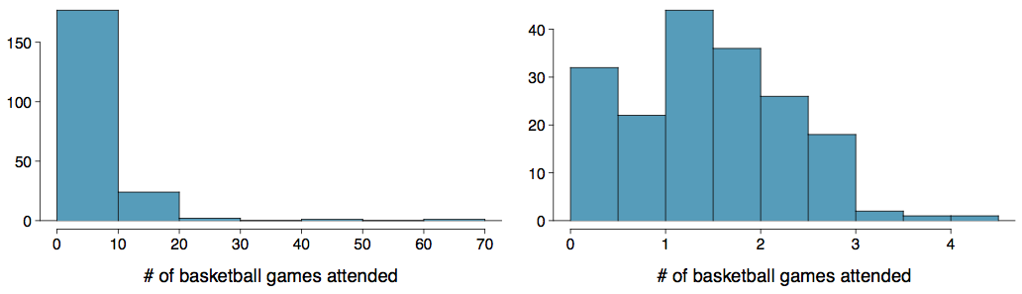
Extremely Skewed Data
When data are extremely skewed, transforming them might make modeling easier. A common transformation is the log transformation.
The histograms on the left shows the distribution of number of basketball games attended by students. The histogram on the right shows the distribution of log of number of games attended.

Slide 58
Pros and Cons of Transformations
Skewed data are easier to model with when they are transformed because outliers tend to become far less prominent after an appropriate transformation.
# of games 70 50 25 …
# of games 4.25 3.91 3.22 ...
However, results of an analysis might be difficult to interpret because the log of a measured variable is usually meaningless.

Slide 59
Pros and Cons of Transformations
Skewed data are easier to model with when they are transformed because outliers tend to become far less prominent after an appropriate transformation.
# of games 70 50 25 …
# of games 4.25 3.91 3.22 ...
However, results of an analysis might be difficult to interpret because the log of a measured variable is usually meaningless.
What other variables would you expect to be extremely skewed?

Slide 60
Pros and Cons of Transformations
Skewed data are easier to model with when they are transformed because outliers tend to become far less prominent after an appropriate transformation.
# of games 70 50 25 …
# of games 4.25 3.91 3.22 ...
However, results of an analysis might be difficult to interpret because the log of a measured variable is usually meaningless.
What other variables would you expect to be extremely skewed?
Salary, housing prices, etc.

Slide 61
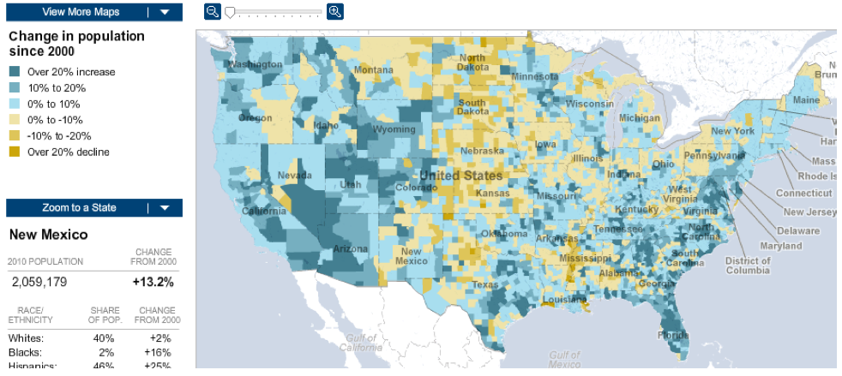
Intensity Maps
What patterns are apparent in the change in population between 2000 and 2010?
http://projects.nytimes.com/census/2010/map

Slide 62
Find more resources at openintro.org/os, including
Slides
Videos
Statistical Software Labs
Discussion Forums (free support for students and teachers)
Learning Objectives
Teachers only content is also available for Verified Teachers, including
Exercise solutions
Sample exams
Ability to request a free desk copy for a course
Statistics Teachers email group
Questions? Contact us.

